Slide 1
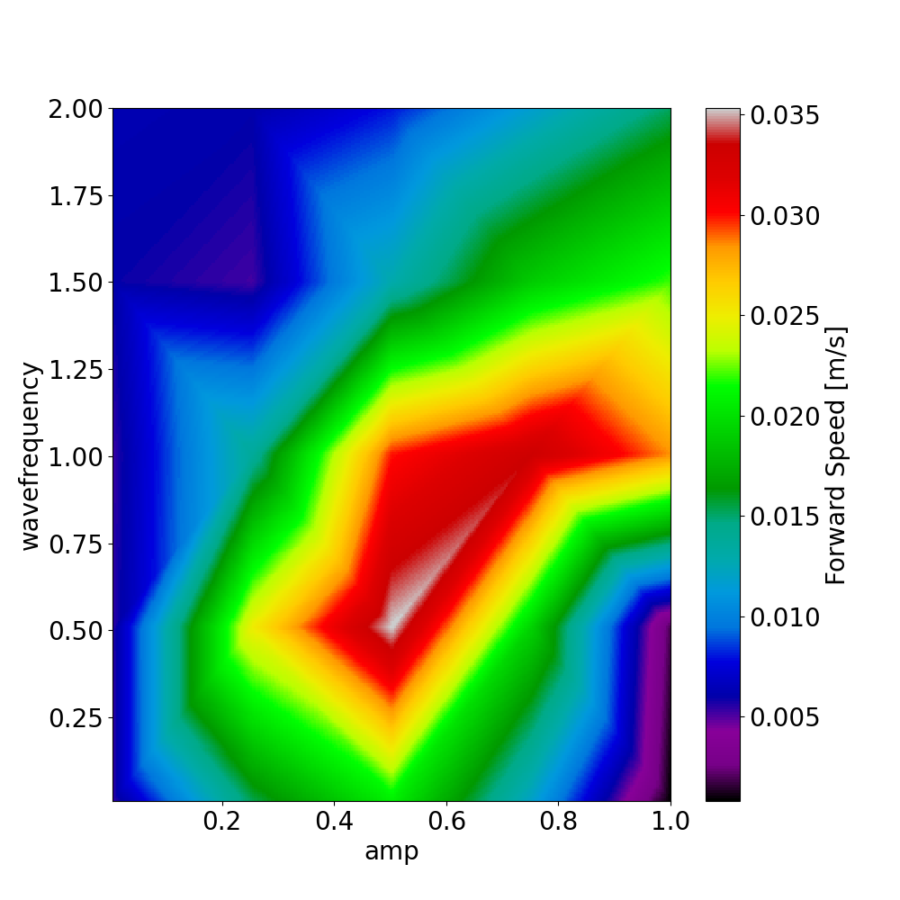
0.4 0.8 1.2 1.6 2

Slide 2
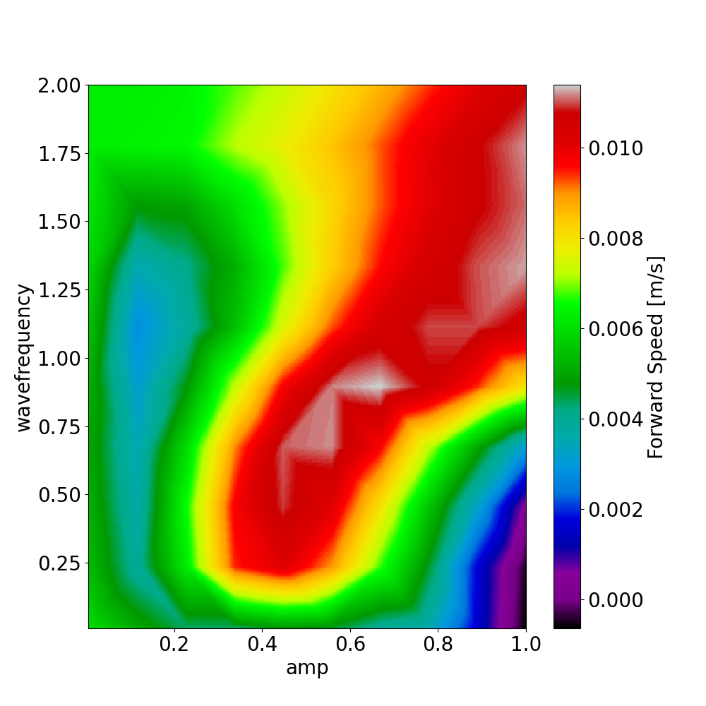
0.4 0.8 1.2 1.6 2

Slide 3
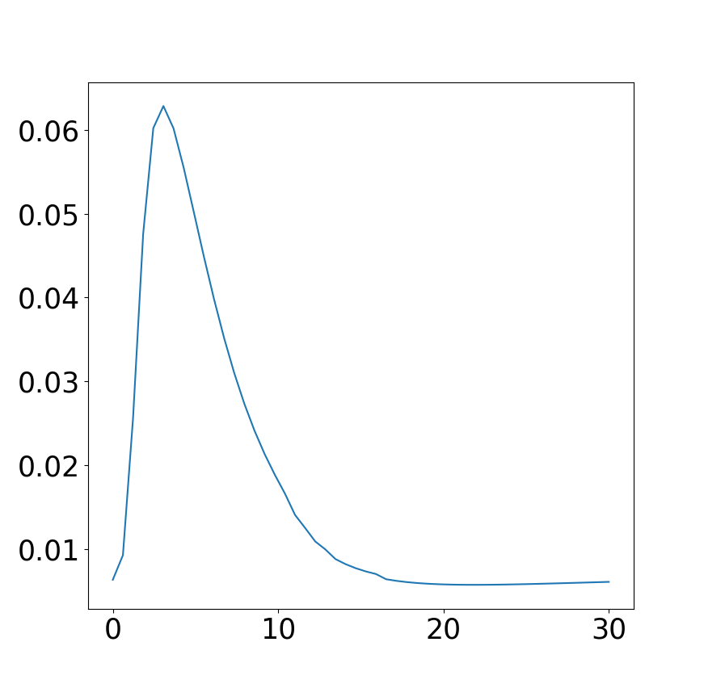
Forward speed [m/s]
lambda

Slide 4
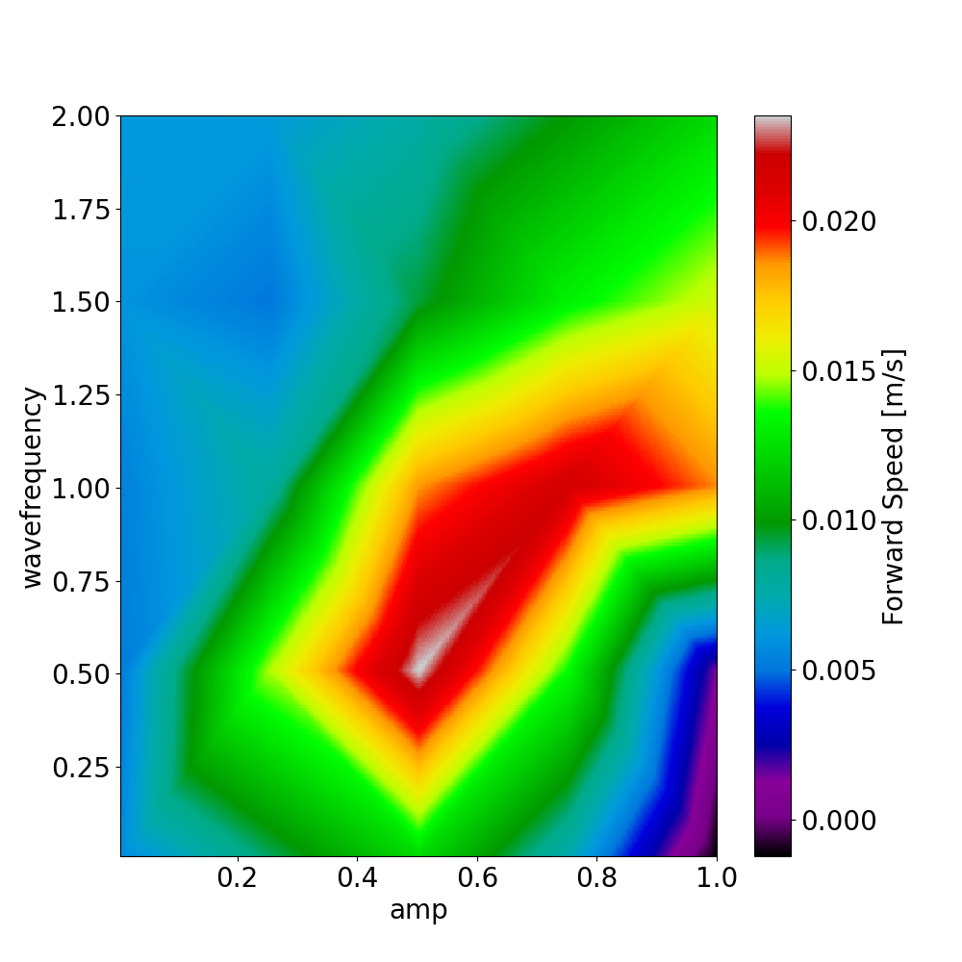
0.4 0.8 1.2 1.6 2

Slide 5
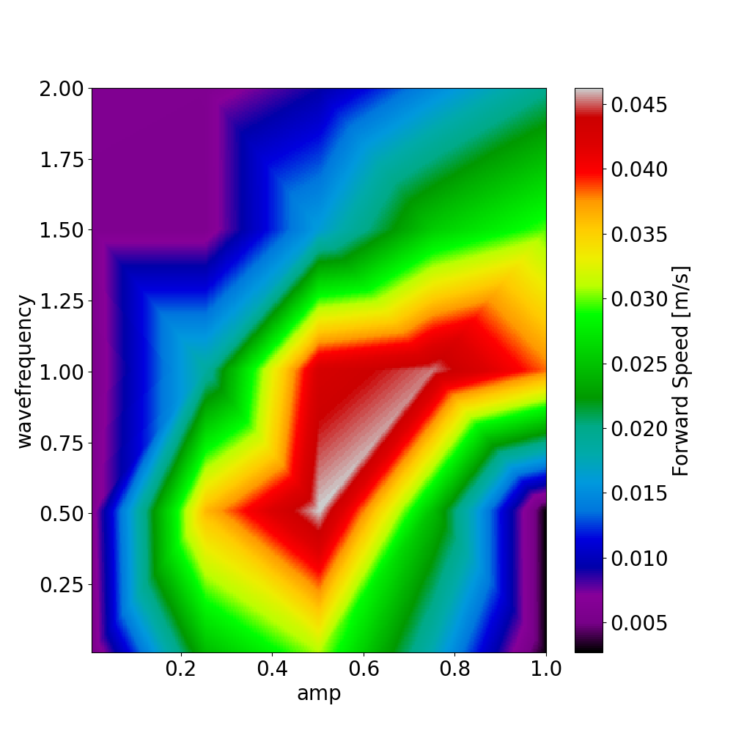
0.4 0.8 1.2 1.6 2

Slide 6
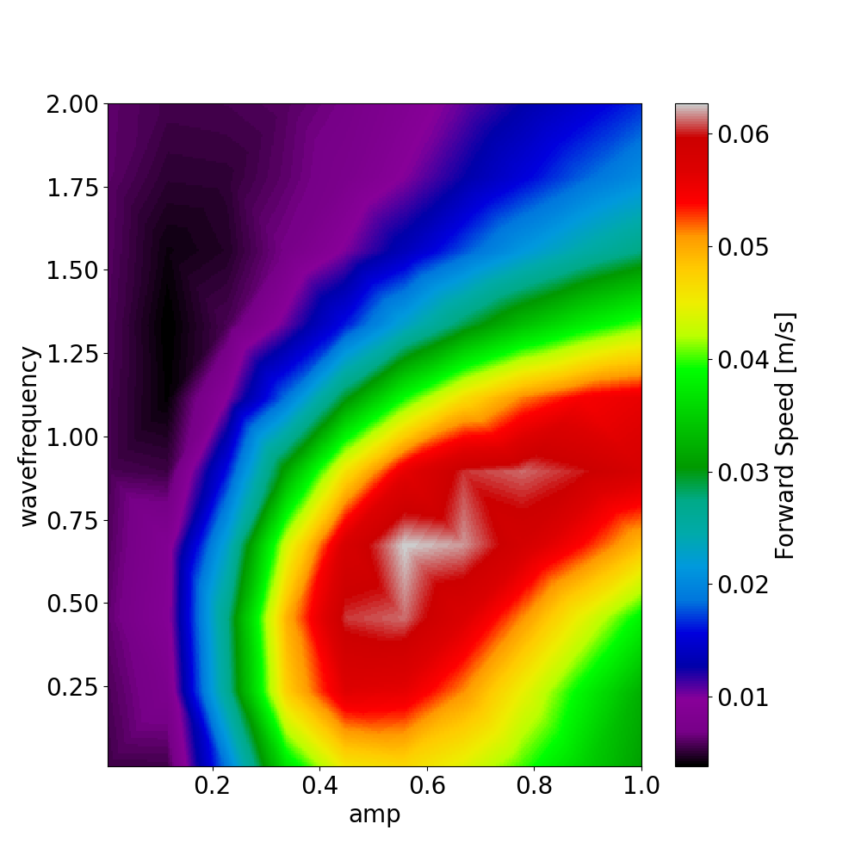
0.4 0.8 1.2 1.6 2

Slide 7
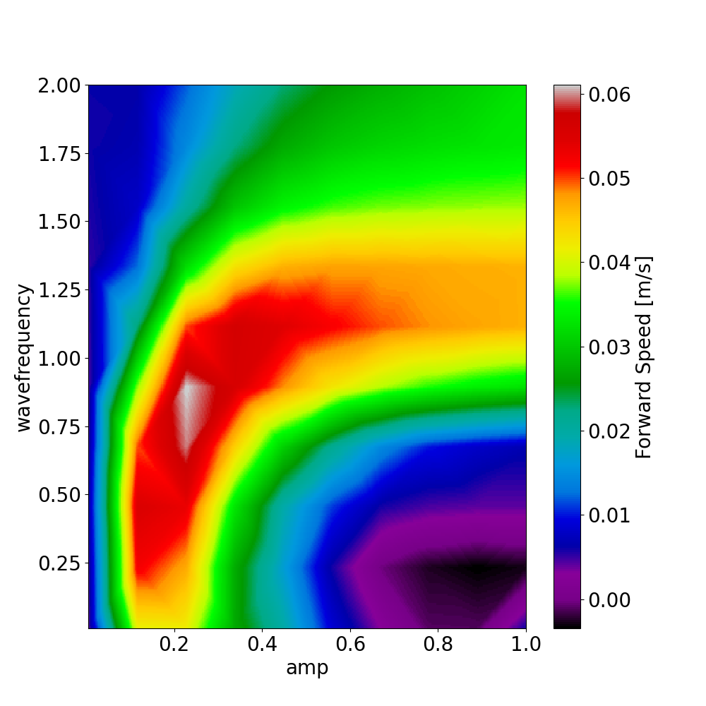
0.4 0.8 1.2 1.6 2

